Slide 1




Panel: VIII. Topic 2: Regional roots, traditions and brands
The intersection between GIs and trade marks
Giuseppe Bertoli
Director of Legal Affairs Department, EUIPO

Slide 2




From Picnic Basket to Dinner Table: The Evolving GI Landscape in the EU
Notes:
Disclaimer: copyright by EUIPO, image created with ChatGPT, March 2026

Slide 3

From Picnic Basket to Dinner Table
All sectors
Same scope of protection
CIGI applications
Notes:
Disclaimer: copyright by EUIPO, image created with ChatGPT, March 2026

Slide 4


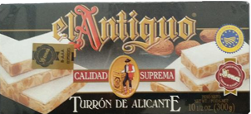
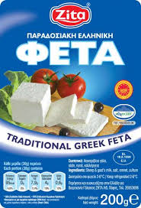
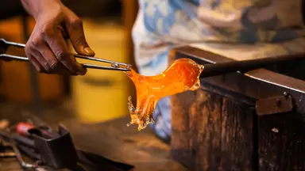
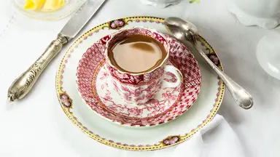
Why GIs matter?
HERITAGE
GUARANTEE OF ORIGIN
Murano glass
QUALITY
CONSUMER TRUST
Porcelaine de Limoges

Slide 5

2
GIs vs Trade Marks – Who wears the crown?

Slide 6
Trade Marks vs GI: Who wears the crown?
Trade Marks
Individual/collective Private rights
Commercial origin
GIs
Collective,
Public rights Geographical origin
Protection of GIs is very strong:
❌ Use, exploitation of reputation
❌ Evocation
❌ Misleading practices,
indications

Slide 7

‘Nero Champagne’ judgment T-239/23 – An impactful case
EUTMA ‘Nero champagne’
applied for i.a.
Wine complying with the specifications of the protected designation of origin ‘Champagne’
versus
PDO ‘Champagne’
Trade marks can include GIs, if properly restricted, but…
Presumption that GI function is safeguarded thanks to restriction is rebuttable…
when undue exploitation of GI’s reputation is demonstrated with concrete, substantiated and consistent evidence/arguments
Notes:
Disclaimer: copyright by EUIPO, image created with ChatGPT, May 2026

Slide 8
Trade Marks vs GI: complementary, not in competition
When a trade mark application:
includes GI as such, not altered or tampered with,
is applied for goods which can comply with product specification (or related services)
and is properly restricted,
it can proceed
Nero Champagne judgment impact
Trade Marks
GIs

Slide 9
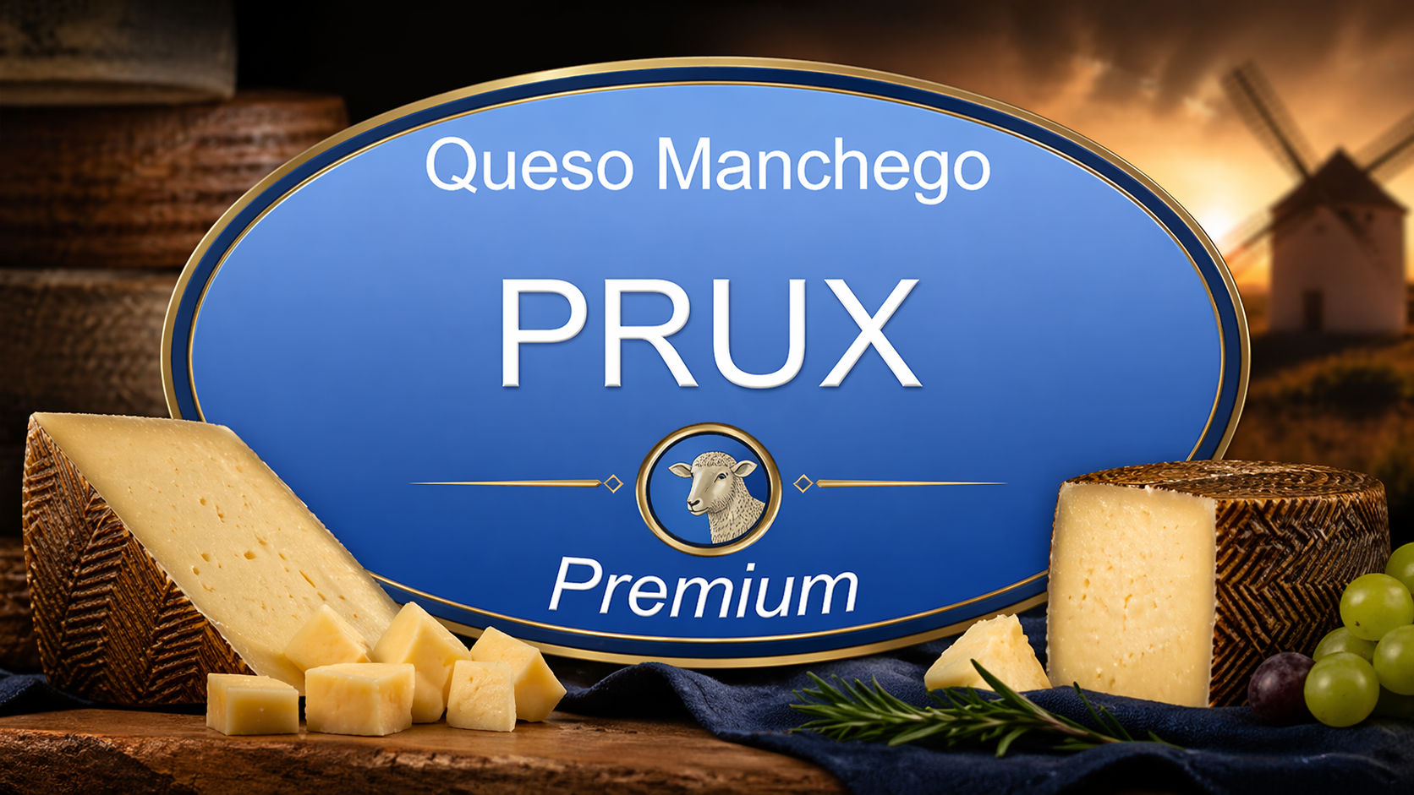
Trade Marks vs GI: complementary, not in competition
Trade Marks
GIs
‘La Rioja Elisabeth’
for ‘La Rioja’ (GI) wine
for ‘Queso Manchego’
(GI) agricultural product
OK
OK
Notes:
Disclaimer: copyright by EUIPO, image created with ChatGPT, April 2026

Slide 10

3
EUIPO’s Role: ex officio examination

Slide 11

Ex officio examination – scope extended
TM application
Ex Officio examination – objection based on information available to EUIPO
TM refused if conflict, unless restricted
Subsequent objection and possible refusal despite restriction !!
NEW!!
Third Party Observations

Slide 12

Evocation – When does it occur? Further clarification
When a Trade Mark
directly triggers an association
with a GI
Incorporates part of a GI or adjective of the GI name
an altered GI name or the entire GI name which interacts with other elements
Trade Mark
refused
Examples
Riojano / La Rioja (GI)
Roqueforino / Roquefort (GI)
Prux Manchego / Queso Manchego (GI)

Slide 13
Trade Marks vs GI: when can a restriction overcome the objection?
‘USE’ of the GI Art. 26(1)(a) Reg 2024/1143 Art. 40(1)(a) Reg 2023/2411 ‘Roquefort Elisabeth’ | Identical goods and related services | Can be restricted
 | Comparable goods | Restriction not possible
 | Processed goods (GI product is ingredient)
‘EVOCATION’ of the GI Art. 26(1)(b) Reg 2024/1143 Art. 40(1)(b) Reg 2023/2411 ‘Roqueforino’ | ANY goods or services

Slide 14

4
GIs as Prior Rights in adversarial proceedings

Slide 15

Why relative grounds disputes still matter?
  Opponent/Invalidity applicant can argue the case
  Opponent has the last word
  Reputation matters – but evidence of exploitation needed
  Notoriety of GI can also be proven and have impact
⚠ Presumption resulting from restriction can be rebutted
Nero Champagne judgment impact

Slide 16

THANK YOU

